Slide 1
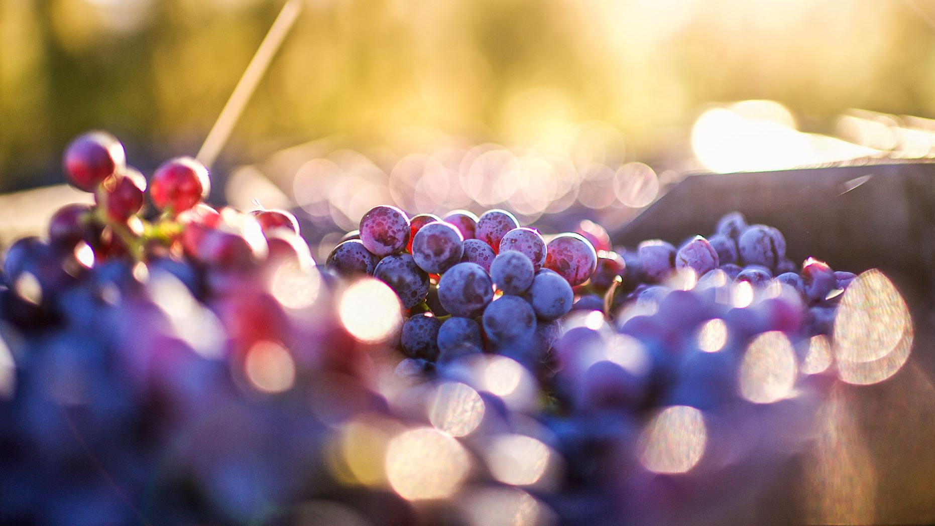
Unsupervised Machine Learning on Wine Quality Data
Clustering, Dimensionality Reduction, and Anomaly Detection Using the UCI Wine Quality Dataset
By Aaron Niecestro
Notes:
This project applies multiple unsupervised machine learning techniques to understand the underlying structure of wine chemistry data.
The analysis investigates clustering behavior, nonlinear structure, dimensionality reduction, and anomaly detection using the UCI Wine Quality dataset.
The goal is to uncover patterns and relationships that exist without relying on target labels.

Slide 2
Project Objective
What Is Unsupervised Learning?
Learns patterns without known target labels
Relies on similarity, distance, and structure
Identifies hidden relationships in data
Goal:
Objective
Natural wine populations
Hidden subgroup structure
Low-dimensional representations
Rare and unusual wine observations
Business Relevance
Quality analysis
Product segmentation
Process monitoring
Rare profile detection
Why it matters
Understanding hidden wine structure can support quality analysis, anomaly detection, and future predictive modeling.
Identify natural structure within wine chemistry data without using target labels.
Identify the following:
Understanding wine chemistry structure can support:
Notes:
Unlike supervised learning, unsupervised learning attempts to discover structure without a predefined target.
This project focuses on determining whether meaningful groups, latent factors, and rare observations exist within the Wine Quality dataset.

Slide 3
Dataset Description
Variable | Description | Was this Feature used for Modeling?
Fixed Acidity | Tartaric acid content | Yes
Volatile Acidity | Acetic acid concentration | Yes
Citric Acid | Citric acid level | Yes
Residual Sugar | Remaining sugar | Yes
Chlorides | Salt concentration | Yes
Free Sulfur Dioxide | SO₂ level | Yes
Total Sulfur Dioxide | Total SO₂ | Yes
Density | Wine density | Yes
pH | Acidity measure | Yes
Sulphates | Sulfate concentration | Yes
Alcohol | Alcohol percentage | Yes
Quality | Wine quality score | Used for interpretation and evaluation
Type | Red or White | Used for interpretation and evaluation
UCI Wine Quality Dataset
Physicochemical measurements collected from Portuguese Vinho Verde red and white wines.
Dataset Size
5,320 observations
11 chemistry features
2 wine types
Quality scores ranging from 3 to 9
Wine Types
Red Wine
White Wine
Notes:
The Wine Quality dataset contains physicochemical measurements collected from red and white Portuguese Vinho Verde wines.
The analysis focuses on eleven chemistry variables that describe acidity, sugar content, sulfur concentration, density, and alcohol content.
Wine type and quality were intentionally excluded from most unsupervised methods and later used for interpretation to determine whether natural structures aligned with known wine categories.
A key advantage of this dataset is that it enables us to evaluate whether meaningful groups emerge naturally from
chemistry alone.

Slide 4
Brief View of Wine Data
Metric | Value
Observations | 5,320
Features | 11 Chemistry Variables
Wine Types | Red & White
Quality Range | 3-9
Avg Alcohol | 10.55%
Avg Residual Sugar | 5.05 g/dm³
Avg pH | 3.22
Avg Total Sulfur Dioxide | 114.11 mg/dm³
Metric | Value
Variable | Mean | Range
Fixed Acidity (g/dm³) | 7.22 | 3.8-15.9
Volatile Acidity (g/dm³) | 0.34 | 0.08-1.58
Residual Sugar (g/dm³) | 5.05 | 0.6-65.8
Total Sulfur Dioxide (mg/dm³) | 114.11 | 6-440
Density (g/cm³) | 0.9945 | 0.987-1.039
pH | 3.22 | 2.72-4.01
Alcohol (% Vol.) | 10.55 | 8.0-14.9

Slide 5
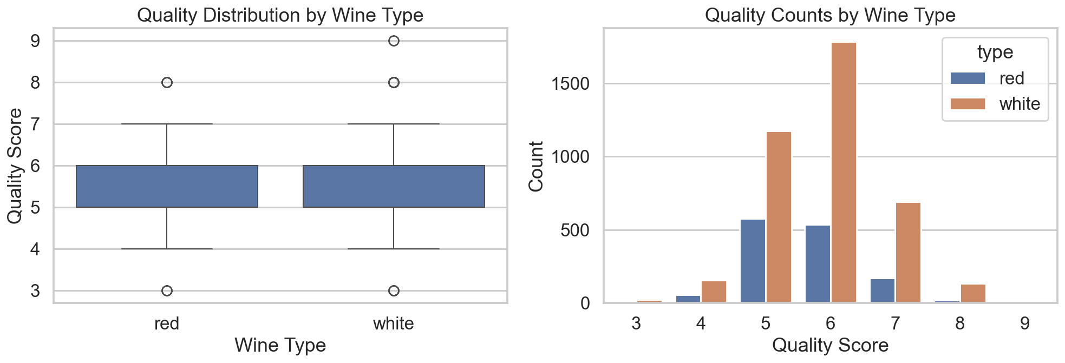
Wine Quality Distribution by Wine Type
Key Findings
Red and white wines exhibit very similar quality distributions.
Both wine types have a median quality score of approximately 6.
Most wines fall within the quality range of 5 to 6.
White wines contain substantially more observations than red wines.
High-quality and low-quality wines are relatively uncommon in both populations.
Interpretation
The similarity in quality distributions suggests that wine type alone does not explain quality differences.
Quality appears to vary continuously rather than forming distinct groups.
This observation provides an early indication that quality may not emerge as a dominant structure during clustering or dimensionality-reduction analysis.
Takeaway
Although red and white wines differ chemically, they display remarkably similar quality distributions. This suggests that factors beyond wine type influence perceived wine quality.
Notes:
Before applying unsupervised-learning methods, the quality distribution of red and white wines was examined.
Both wine types exhibited similar median quality scores andcomparable overall distributions.
Most wines received scores between 5 and 6, while very lowand very high quality ratings were relatively uncommon.This finding was important because it suggested early in theanalysis that wine quality might not be the dominant sourceof structure within the dataset.Later clustering and dimensionality-reduction analysesconfirmed this observation, showing that wine type drivesmuch stronger separation than quality.

Slide 6
Data Preparation & Analysis Approach
Data Preparation
The original red and white wine datasets were combined into a single analysis dataset and prepared using a consistent preprocessing workflow.
Preparation Steps
Combined red and white wine datasets
Added wine type indicator
Removed duplicate observations
Standardized chemistry features
Prepared feature matrix for unsupervised learning
Why This Matters
Proper preprocessing ensures that all wine chemistry variables contribute fairly to distance calculations, clustering behavior, dimensionality-reduction embeddings, and anomaly-detection results.
Notes:
Before applying unsupervised-learning techniques, the combined wine dataset was cleaned and standardized to ensure consistent feature scaling.
Standardization was particularly important because many of the algorithms used in this project rely on distances and feature-space geometry. Without scaling, variables such as sulfur dioxide could dominate smaller-scale measurements such as pH.
The analysis followed a structured workflow beginning with clustering methods, followed by dimensionality reduction, and concluding with anomaly detection and final method comparisons.

Slide 7
Clustering Explained
Why Clustering?
Clustering groups observations with similar characteristics together without using pre-defined labels.
The goal is to determine whether natural wine populations exist based solely on chemistry measurements.
Why Compare Multiple Methods?
Different clustering algorithms make different assumptions about the data.
By comparing multiple approaches, we can determine whether discovered wine populations represent genuine structure rather than artifacts of a single algorithm.
Model Evaluation Criteria:
Silhouette Score
Davies-Bouldin Index
Cluster Interpretability
Visualization Quality
Stability Across Solutions
Notes:
Clustering was the first major analysis performed in the project.
Several clustering methods were evaluated because each approach detects structure differently.
K-Means identifies compact groups, GMM models overlapping populations, Agglomerative Clustering reveals hierarchical relationships, and DBSCAN discovers density-based
structure.
Comparing multiple clustering algorithms increases confidence in findings that appear consistently across methods.
The primary question was whether meaningful wine populations emerge naturally from chemistry measurements alone.

Slide 8
Clustering Methods
K-Means
Centroid-based clustering
Assigns wines to the nearest cluster center
Works best with compact, spherical groups
Primary Strength was a fast baseline clustering
Gaussian Mixture Models (GMM)
Probabilistic clustering
Allows observations to belong to multiple clusters partially
Useful when cluster boundaries overlap
Primary Strength was probabilistic cluster membership
Agglomerative Clustering
Hierarchical clustering approach
Builds clusters through progressive merging
Reveals nested relationships between wines
Primary Strength was hierarchical structure
DBSCAN
Density-based clustering
Detects irregularly shaped clusters
Automatically identifies noise and outliers
Primary Strength was density based clustering

Slide 9
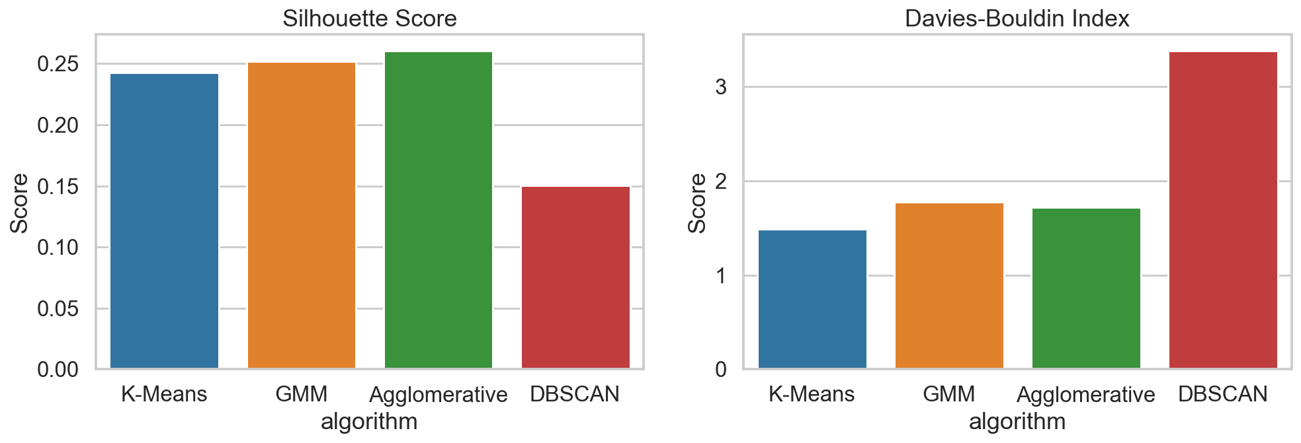
Clustering Results & Model Comparison
Key Findings
Agglomerative Clustering achieved the highest Silhouette Score (0.26).
K-Means achieved the lowest Davies-Bouldin Index.
DBSCAN produced the weakest clustering performance.
Ward Linkage Agglomerative Clustering was selected as the preferred clustering approach.
K-Means achieved the lowest Davies-Bouldin Index (1.48).
GMM produced similar performance to K-Means and Agglomerative.
DBSCAN produced substantially weaker cluster quality across both metrics.

Slide 10
Clustering Results
Clustering Results
Four clustering approaches were evaluated to determine whether natural wine populations can be inferred from chemical measurements alone.
The best clustering solution: Ward Linkage Agglomerative Clustering
Produced clear wine population separation
Revealed meaningful hierarchical structure
Identified potential subgroup relationships
Generated interpretable dendrograms
Consistent with dimensionality-reduction findings
Key Findings
Red and white wines formed distinct populations across multiple clustering methods.
Cluster quality consistently improved when hierarchical structure was considered.
Hierarchical clustering revealed additional subgroup structure within both wine populations.
Wine quality scores remained distributed across clusters and did not form independent clusters.
Major Insight
The strongest clustering signal in the dataset was Wine type.
Additional evidence suggested nested subgroup structure within both populations.
Conclusion
Multiple clustering methods independently identified wine type as the dominant source of variation within the dataset, while hierarchical clustering provided the most interpretable representation of wine population structure.
Strongest cluster was Red Wines vs. White Wines
Notes:
The clustering analysis demonstrated that wine chemistry naturally separates into distinct populations.
The strongest and most consistent structure corresponded to red and white wine types.
While K-Means and GMM identified broad population differences, hierarchical clustering provided additional insight into relationships between groups.
Ward linkage emerged as the strongest clustering approach because it produced clear separation while simultaneously revealing evidence of subgroup structure within the larger
wine populations.
Importantly, wine quality did not form independent clusters, suggesting that quality varies continuously rather than through distinct chemistry-based groups.

Slide 11
Dimensionality Reduction Methods
Why Dimensionality Reduction?
Wine chemistry contains multiple correlated variables that can be difficult to visualize and interpret simultaneously.
Dimensionality reduction transforms high-dimensional chemistry data into a smaller set of variables while preserving as much meaningful structure as possible.
This method helps:
Visualize wine populations
Reveal hidden structure
Identify nonlinear relationships
Reduce dimensional complexity
Improve interpretation
Objective
Each method was evaluated on:
Interpretability
Visual separation
Structure preservation
Nonlinear relationship discovery
Chemistry factor interpretation
Key Question
Which dimensionality-reduction technique provides the most informative low-dimensional representation of the Wine Quality dataset?
Evaluation Goals
Determine which dimensionality-reduction technique provides the most informative representation of wine chemistry while preserving meaningful structure.

Slide 12
Methods Evaluated
Principal Component Analysis (PCA)
What is it?
A linear dimensionality-reduction technique that identifies directions of maximum variance within the data.
Why use it?
Preserves variance
Produces interpretable loadings
Establishes a baseline representation
Kernel PCA
What is it?
A nonlinear extension of PCA that uses kernel functions to reveal curved and complex relationships.
Why use it?
Captures nonlinear structure
Improves separation when PCA is limited
Reveals hidden geometry in feature space
t-SNE
What is it?
A nonlinear embedding method that focuses on preserving local neighborhood relationships.
Why use it?
Excellent for visualization
Reveals cluster separation
Highlights local population structure
UMAP
What is it?
A nonlinear manifold-learning algorithm that preserves both local and global relationships.
Why use it?
Strong cluster separation
Maintains broader dataset structure
Generates highly interpretable visualizations
Non-Negative Matrix Factorization (NMF)
What is it?
A factorization technique that represents data as additive non-negative components.
Why use it?
Produces interpretable latent factors
Identifies chemistry building blocks
Explains how wine characteristics combine
Notes:
Dimensionality reduction was used to investigate the underlying geometry of the wine chemistry data.
PCA served as the baseline linear approach, while Kernel PCA, t-SNE, and UMAP explored nonlinear structure.
NMF was included because it provides a fundamentally different perspective by identifying additive latent chemistry factors instead of focusing on visualization.
Together, these methods allow us to determine whether wine populations separate naturally and whether hidden structure exists beyond what is visible in the original feature space.

Slide 13
Methods Major Findings
PCA
Explained nearly 50% of variance using two components
Clearly separated red and white wines
Provided interpretable feature loadings
Primary strength is Variance Explanation
Kernel PCA
Revealed nonlinear chemical structure
Improved separation relative to standard PCA
Best method for Nonlinear Structure Discovery
Primary strength: Nonlinear Structure Discovery
t-SNE
Produced outstanding local cluster separation
Revealed highly distinct wine populations
UMAP
Produced the strongest overall embedding
Balanced separation and structure preservation
Generated the clearest visualization
NMF
Identified interpretable chemistry components
Revealed latent additive wine characteristics
Best method for Variance Explanation
Best method for Local Cluster Separation
Primary strength is nonlinear structure discovery
Best method for overall visualization
Primary strength was local and global structure preservation
Best Method for feature interpretation
Primary strength was latent chemistry interpretation
Notes:
Dimensionality reduction provided one of the strongest sources of evidence in the entire project.
Despite using fundamentally different mathematical approaches, PCA, Kernel PCA, t-SNE, UMAP, and NMF all identified wine type as the dominant source of variation.
UMAP produced the strongest overall visualization because it maintained strong separation while preserving broader dataset structure.
NMF contributed a different perspective by identifying interpretable chemistry factors rather than focusing on visualization.
The consistency across methods increases confidence that the detected wine populations reflect genuine underlying structure rather than artifacts of a specific algorithm.

Slide 14
Findings and Conclusion
Most Important Finding:
Wine Type was the Dominant Source of Variation,while Quality Scores remained Highly Overlapping
All dimensionality-reduction methods consistently identified wine type as the strongest source of structure within the dataset.
Conclusion
Multiple dimensionality-reduction techniques independently arrived at the same conclusion:
Red and white wines form distinct populations.
Quality scores do not form clearly separated groups.
UMAP provided the strongest overall visualization.
NMF delivered the strongest chemistry interpretation.

Slide 15
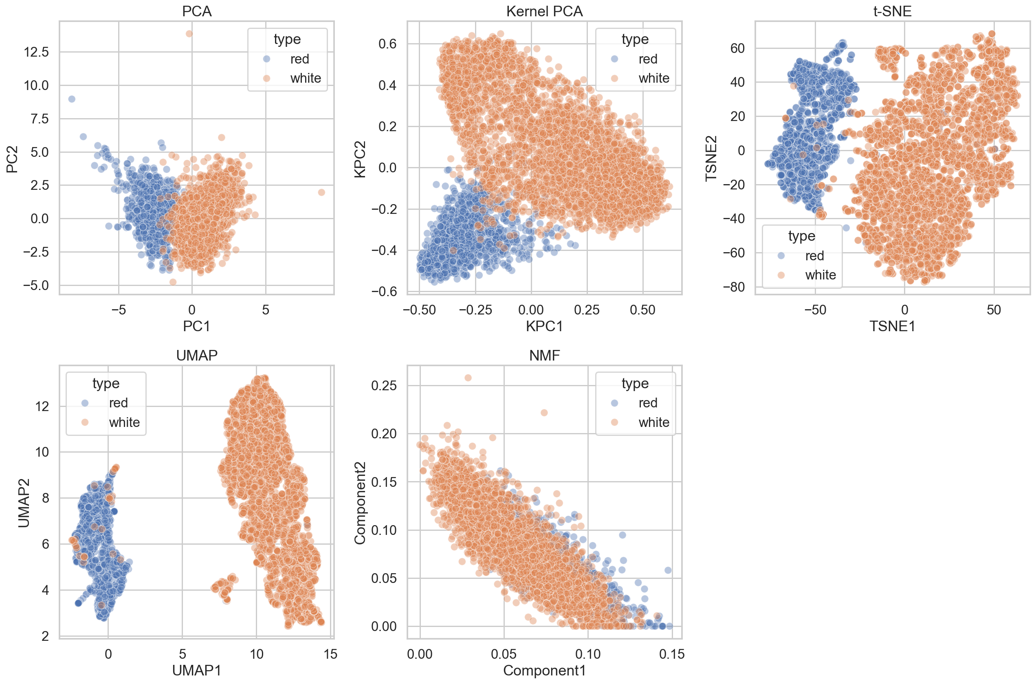
Dimensionality Reduction Comparison
Key Findings
All dimensionality-reduction methods identified wine type as the dominant source of variation.
Red and white wines formed distinct populations across multiple embeddings.
Nonlinear methods produced stronger separation than linear PCA.
Wine quality remained highly overlapping and did not form clear low-dimensional groups.
Multiple methods suggested evidence of internal subgroup structure.

Slide 16
Anomaly Detection Methods
Why Anomaly Detection?
Not all wines fit naturally into clusters or populations.
Anomaly detection identifies wines whose chemistry differs significantly from the rest of the dataset.
These observations may represent:
Rare chemical profiles
Production inconsistencies
Extreme wine styles
Observations that influence clustering structure
Isolation Forest
What is it?
An unsupervised anomaly-detection algorithm that isolates observations using random feature splits.
How does it work?
Observations that require fewer splits to isolate are considered more unusual.
What does it detect?
Global anomalies
Chemistry extremes
Observations far from the overall population
Local Outlier Factor (LOF)
What is it?
A density-based anomaly-detection algorithm that compares each observation to its nearest neighbors.
How does it work?
Observations with substantially lower local density than surrounding wines are classified as anomalous.
What does it detect?
Local anomalies
Sparse neighborhood observations
Unusual wines hidden within larger populations
Why Compare Both Methods?
Both methods define anomalies differently.
Isolation Forest → Globally Unusual Wines
LOF → Locally Unusual Wines
Using both approaches provides a more complete understanding of rare and unusual wine chemistry profiles.
Key Question
Do globally unusual wines and locally unusual wines represent the same observations?

Slide 17
Anomaly Detection Results
Objective
Determine whether unusual wine observations exist within the dataset and evaluate how different anomaly-detection techniques characterize rare wine chemistry profiles.
Isolation Forest
Focused on globally unusual wines
Identified predominantly red wine anomalies
Highlighted chemistry extremes
Most anomalies occurred along outer boundaries of feature space
Local Outlier Factor (LOF)
Focused on locally unusual wines
Identified predominantly white wine anomalies
Detected sparse neighborhood behavior
Found unusual wines throughout feature space
Most Important Insight
Global Anomalies ≠ Local Anomalies
Only 36.09% of anomalies were identified by both methods.
This suggests that rare wine behavior exists at multiple scales and cannot be fully characterized using a single anomaly-detection technique.
Conclusion
Isolation Forest and LOF revealed complementary aspects of anomaly structure within the Wine Quality dataset.
Red wines were more likely to exhibit globally extreme chemistry profiles, while white wines were more likely to exhibit locally unusual chemistry patterns.
Total:266
Red:164
White: 102
Anomalies Detected
Anomalies Detected
Total:266
Red: 87
White: 179
Notes:
The anomaly-detection analysis produced one of the most interesting results in the project.
Although both methods identified exactly 266 anomalies, they disagreed on most observations.
Only 96 wines were classified as anomalous by both methods, corresponding to an agreement rate of 36.09%.
This low overlap demonstrates that anomaly detection is highly dependent on how unusual behavior is defined.
Isolation Forest identified globally extreme wines, particularly among red wines.
LOF identified locally unusual wines, particularly among white wines.
Together, these methods provided a more complete picture of rare wine chemistry profiles than either approach alone.

Slide 18
Key Findings & Insights
Wine Type Is the Dominant Source of Variation
Across clustering, dimensionality reduction, and anomaly-detection methods, red and white wines consistently formed distinct populations.
Evidence was observed in:
Clustering results
Hierarchical clustering
PCA
Kernel PCA
t-SNE
UMAP
NMF
Wine Quality Does Not Form Natural Groups
Wine quality scores remained highly overlapping across:
Clusters
PCA space
Nonlinear embeddings
Latent-factor representations
This suggests that wine quality behaves more like a continuous spectrum than a set of distinct chemistry groups.
Additional Subgroup Structure Exists
Ward Linkage, Kernel PCA, t-SNE, and UMAP all suggested the presence of meaningful subpopulations within both red and white wines.
The data contains more structure than a simple:
Red Wine vs. White Wine separation
UMAP Produced the Strongest Visualization
Among all dimensionality-reduction methods:
Different Anomaly Methods Reveal Different Behaviors
Only 36.09% of anomalies were shared between methods.
This indicates that anomaly behavior depends strongly on how unusual observations are defined.
Overall Project Insight
Multiple independent methods arrived at the same conclusion:
Wine Type drives the majority of structure within the Wine Quality dataset.
Best separation
Best structure preservation
Most interpretable embedding
Provided the clearest representation of the dataset
Notes:
Speaker Notes
The strongest evidence generated by this project comes from the agreement between independent unsupervised-learning methods.
Clustering, dimensionality reduction, and anomaly detection all identified wine type as the dominant source of variation.
Quality scores remained highly overlapping throughout the analysis, while additional subgroup structure appeared within both wine populations.
The consistency of findings across multiple techniques increases confidence that these patterns reflect genuine properties of the dataset rather than artifacts produced by individual algorithms.
This convergence of evidence is one of the strongest outcomes of the project

Slide 19
Final Recommendations
Ward Linkage
Produced the most interpretable clustering structure
Revealed hierarchical relationships between wines
Identified meaningful subgroup structure
UMAP
Generated the clearest low-dimensional representation
Preserved local and global structure
Consistently separated wine populations
NMF
Revealed interpretable latent chemistry components
Explained how wine characteristics combine
Isolation Forest & LOF
Identified complementary anomaly types
Captured both global and local outlier behavior
Recommended Analytical Workflow
Ward Clustering
↓
UMAP Visualization ↓
NMF Interpretation
↓
Isolation Forest + LOF
This combination provides the strongest balance between:
Structure discovery
Interpretability
Visualization quality
Outlier identification
Practical Takeaway
No single unsupervised-learning algorithm was optimal for every task.
The strongest results were obtained by combining multiple complementary techniques.
Using clustering, dimensionality reduction, and anomaly detection together provided a much more complete understanding of wine chemistry structure than any method alone.
Notes:
Speaker Notes
One of the most important lessons from this project is that different unsupervised-learning methods answer different questions.
Ward linkage was most effective for discovering hierarchical population structure.
UMAP provided the strongest visualization and made wine populations easy to interpret.
NMF delivered the most meaningful chemistry-based interpretation. Isolation Forest and LOF identified different forms of anomalous behavior and together provided a more complete view of unusual wines.
The strongest approach is therefore not selecting a single best algorithm but combining complementary methods to gain
multiple perspectives on the data.

Slide 20
Goals and Recommended Methods
Analysis Goal | Recommended Method
Overall Clustering | Ward Linkage Agglomerative Clustering
Hierarchical Structure Discovery | Ward Linkage
Variance Explanation | PCA
Nonlinear Structure Discovery | Kernel PCA
Local Cluster Separation | t-SNE
Overall Visualization | UMAP
Chemistry Interpretation | NMF
Global Anomaly Detection | Isolation Forest
Local Anomaly Detection | LOF

Slide 21
Dataset Limitations
Unsupervised Learning Challenges
Unlike supervised learning, there is no known "correct" answer for clusters, latent factors, or anomalies.
As a result, many findings require interpretation rather than direct validation.
Dataset Feature Limitations
The dataset contains only physicochemical measurements and does not include:
Grape variety
Region of origin
Production methods
Storage conditions
Expert tasting notes
These factors may provide additional insight into wine behavior.
Quality Scores Remain Subjective
Wine quality scores are based on sensory evaluations and may vary across evaluators.
As a result:
Quality may not align perfectly with chemistry
Quality groups may naturally overlap
Notes:
Although the project uncovered consistent patterns, severallimitations should be considered when interpreting the results.
The dataset contains only chemistry measurements and lacks many real-world factors that may influence wine variation.
Additionally, unsupervised learning does not provide a ground-truth answer, making interpretation inherently more subjective than supervised classification.

Slide 22
Method Limitations
Clustering Method Limitations
Cluster interpretation is subjective
Different algorithms may produce different group structures
No ground-truth cluster labels exist
Dimensionality Reduction Method Limitations
PCA may overlook nonlinear structure
t-SNE and UMAP can distort distances during projection
Visual separation does not always imply true cluster structure
Anomaly Detection Method Limitations
Isolation Forest and LOF use different definitions of anomalies
Results depend on algorithm assumptions
Rare observations are not always errors or defects
Key Limitation
Unsupervised methods identify structure, but they cannot directly explain why that structure exists.
Domain knowledge is still required to interpret results correctly.
Notes:
Different clustering, dimensionality-reduction, and anomaly detection methods can produce different views of the same data.
For this reason, the strongest conclusions come from patterns that appeared repeatedly across multiple methods.
This slide directly satisfies the "limitations" portion of the grading rubric and mirrors the limitations slide that helped your previous report score well.

Slide 23
Next Steps
Additional Clustering Approaches
Evaluate more advanced clustering techniques:
HDBSCAN
Spectral Clustering
Affinity Propagation
These methods may reveal additional subgroup structure not detected by current models.
Enhance Distance & Similarity Analysis
Investigate alternative distance metrics:
Manhattan Distance
Cosine Similarity
Mahalanobis Distance
Different distance definitions may alter cluster structure and anomaly detection performance.\
Improve Anomaly Analysis
Evaluate the impact of anomalies on clustering results by:
Removing detected anomalies
Re-running clustering methods
Comparing cluster stability before and after removal
This would help determine how strongly rare wines influence discovered populations.
Add Cluster Interpretation
Develop a hybrid supervised-unsupervised workflow:
Cluster Assignment → Classification Model → Feature Importance / SHAP
This would provide direct explanations for cluster membership and improve interpretability.
Extend Dimensionality Reduction
Future analysis could explore:
Three-dimensional embeddings
Autoencoders
Variational Autoencoders (VAE)
Deep representation learning
These methods may reveal additional nonlinear structure.
Long-Term Goal
Develop an integrated exploration framework that combines:
Clustering
Dimensionality Reduction
Anomaly Detection
Explainable AI to support deeper understanding of wine chemistry and population structure.

Slide 24
Project Conclusion
Project Objective Achieved
This project successfully applied clustering, dimensionality reduction, and anomaly-detection techniques to uncover hidden structure within the Wine Quality dataset.
Major Conclusions
Wine Type Drives Dataset Structure – Red and white wines consistently formed distinct populations across nearly all unsupervised learning methods evaluated.
Wine Quality Remains Highly Overlapping– Quality scores did not form clearly separated chemistry groups and behaved more like a continuous spectrum than distinct categories.
Additional Subgroups Exist – Multiple methods revealed evidence of meaningful subgroup structure within both red and white wine populations.
No Single Method Was Best at Everything
Multiple Methods Reinforced the Same Findings – One of the strongest outcomes of the project was the consistency of results across independent techniques.
Clustering, dimensionality reduction, and anomaly detection all pointed toward the same fundamental structure within the dataset.
Final Takeaway
Wine Type → Primary Structure
Subgroups → Secondary Structure
Quality → Highly Overlapping
Anomalies → Method Dependent
Together, these findings provide a comprehensive understanding of wine chemistry structure and demonstrate the value of combining multiple unsupervised-learning techniques when exploring complex datasets.
Notes:
The goal of this project was to determine whether hidden structure exists within wine chemistry data without relying on predefined labels.
Across all analyses, wine type emerged as the dominant source of variation, while quality remained highly overlapping.
Several methods also suggested the presence of additional subgroups within both wine populations.
Perhaps the most important lesson is that different unsupervised-learning techniques answer different questions. When used together, they provide a far richer understanding of the data than any single algorithm alone.
The consistency of findings across clustering, dimensionality reduction, and anomaly detection increases confidence that the observed structures represent genuine properties of the Wine Quality dataset.

